Slide 1
Content Objective: Students will read Imperfect Match and determine biases in data, the #1 weakness of A.I. systems.
Tuesday Dec 10th
Unit 2 - Technical Basics of A.I.
Data Representation / Pattern Recognition
Eleanor Haberl’s Short Story “Imperfect Match”
Homework
No homework in the course. But I will make you think!

Slide 2


What is Artificial Intelligence actually? Is it something to be afraid of? Remember the medical data collector IBM Watson...
Remember the “smart” piece of paper...is a fancy computer any different?

Slide 3
Computer Vision
On a piece of paper draw what a computer might see when it looks at the image below...
What is it called when a computer notices a large difference between one color and another?

Slide 4
Qualitative Data vs Quantitative Data
A hot room vs a cool room
Hard Exam vs Easy Exam
A full cup vs an empty cup
A loud party vs a quiet party
102 F vs 24 F
64% vs 97%
12 litres vs 0 litres
40 decibels vs 80 decibels

Slide 5

Data Representation
How can we identify people in this room in unique ways by asking specific questions? How could a computer sort through us to isolate unique people?
In other words we want qualitative data that can help separate us by certain non-numerical characteristics.

Slide 6
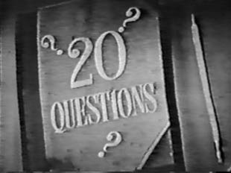
Data Representation / Pattern Recognition
Let’s play an old school game that has been around since the 1800’s...

Slide 7
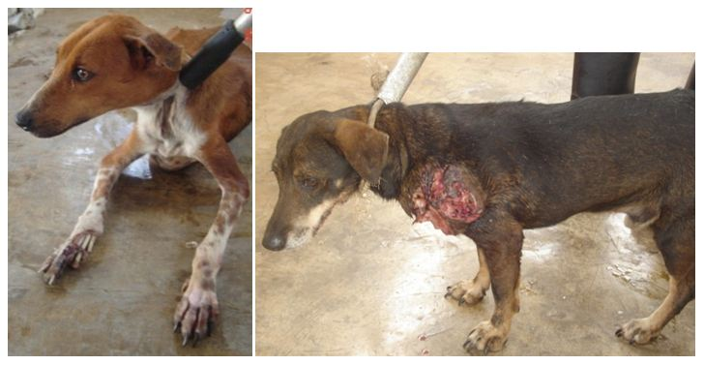
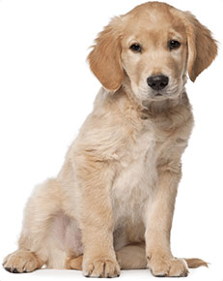
Pattern Recognition
Eleanor Haberl’s “Imperfect Match”
The Story of Tater Tot
Which of these dogs would you want to take home with you? Why?
vs.

Slide 8

Pattern Recognition
Questions 3 and 4 on the discussion guide portion of the story ask about your pet preference, ethnicity, and family size.
Let’s collect the data of our classroom and see if we can determine any patterns. Do these patterns have significance or not?
The last question asks about how we can improve the AI system in this story. What are some of your thoughts?

Slide 9
Decision Tree
Why would I make us do this activity when we are talking about computers / AI?

Slide 10
Turn n’ Talk
Where do you place the worker who squashed the fly on your ethical spectrum (evil-good)? Why did you place it there?
Where do you place the robot women getting killed for fear of her killing her masters? Why did you place it there?
Of the three scenarios (Second Renaissance, Yogurt Taking Over, Sophia’s Utopian Dream) which do you think is the most likely? Why?

Slide 11
Class Ethical Data on Abortion
AI “Sees” Data / Used to Make Decisions
Should we make laws based on ethical data such as this?
17 Students Total
3 - No Opinion
2 - Good (save mother's life, prevent unwanted pregnancy, ease financial strain, prevent damaging foster care placement)
1 - Evil (should never take a life, except in matters of rape, mother endangerment)
12 - Neutral (Difficult choice for any mother, ¼ women get one at some point in their lifetime, most are already married and have children)
More on AI using Data to make choices tomorrow!

Slide 12
What is AI actually?

Slide 13
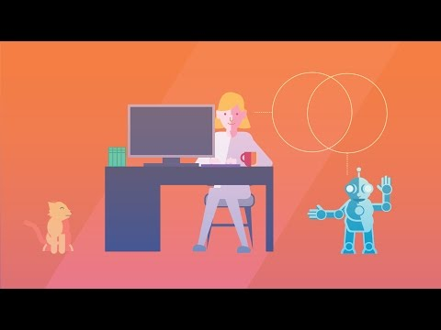
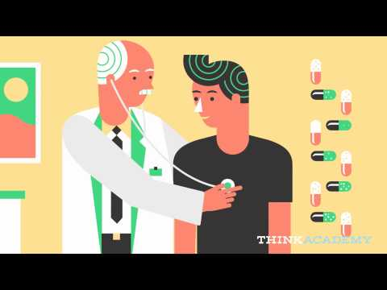
What is AI Wrap Up Video IBM Watson

Slide 14
How does a computer “see”?
Edge Detection Cat Slides

Slide 15
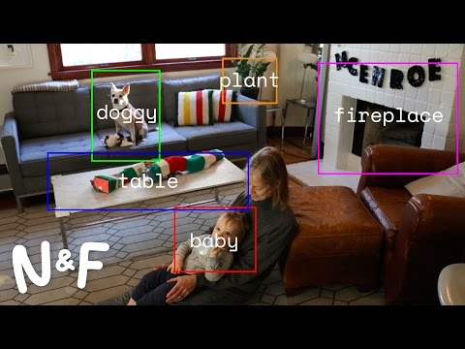
Computer Vision

Slide 16
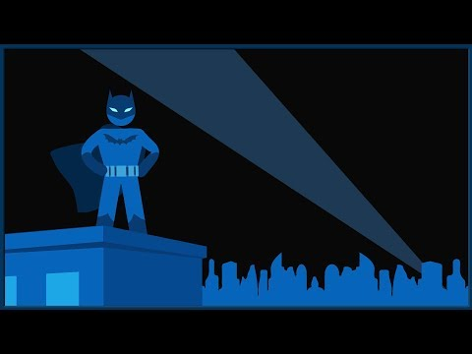
The “Gray Jedi Code” has a real name...

Slide 17
Day 1 - Social Impact
Why is it important to consider ethics and AI?
What is society? What do we view as being a good or bad society?
Who are the ones making the machines? Programming the machines? As we will learn later on, AI learns from us...are we always a good example?
See Hanson Robotics Website ----> Sophia
What might the ethical code of these people be as they create this robot?
Do you think they have similar or different ethics to us here in the classroom?

Slide 18
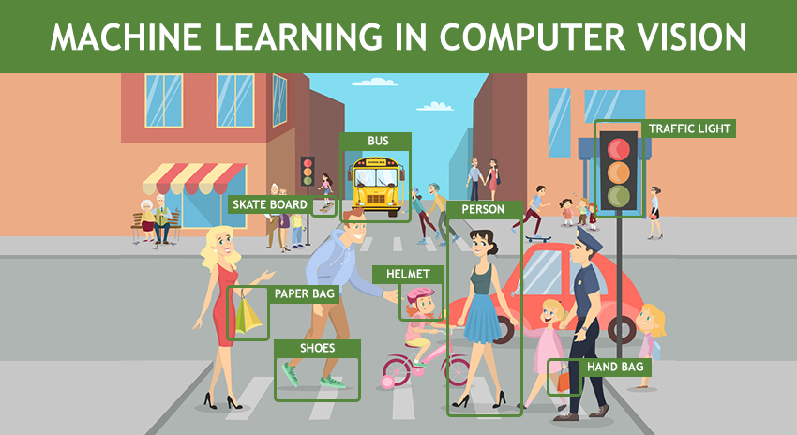
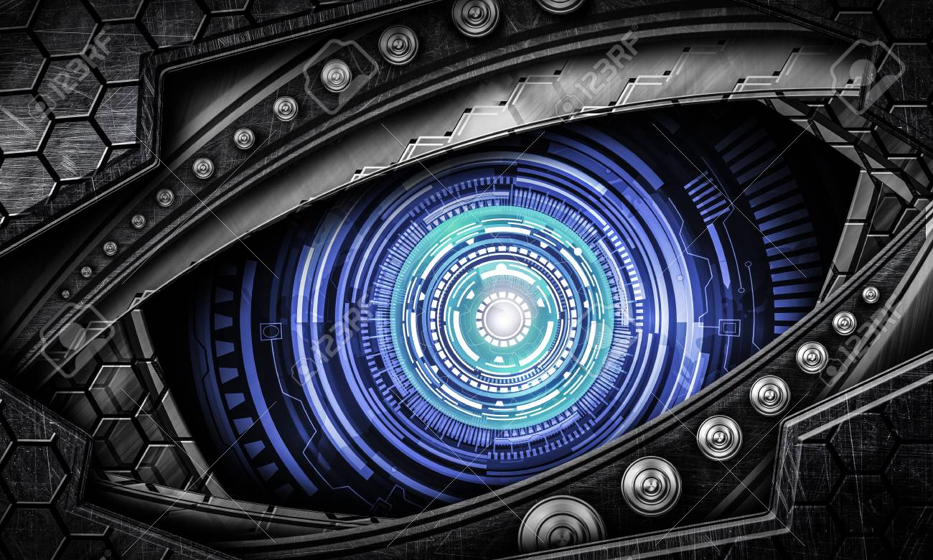
Tomorrow - Perception
What is Artificial Intelligence actually?
Computer Vision
How does a computer “see”?
Ethics of Perception

Slide 19
Scenario 1 - The Day the Yogurt Took Over
Scenario 2 - The Second Renaissance (warning: 9 min in - disturbing scene)
Scenario 3 - Sophia Talks About Her Plan
Let’s look at three different societal scenarios...categorize these as being either “evil,” “neutral,” or “good.” Come up with reasons why you feel these outcomes are good or bad and be ready to defend your thinking. Jot down significant moments that seem to go against (or with) your own ethical code.

Slide 20
Which Scenario do you believe is the most likely?
Get in a group of 2-3 and construct an argument for which one of these scenarios you believe is the most likely to play out in the future. Compare / contrast your ethical codes to help guide you. Write 2-3 paragraphs to defend your reasoning.
The goal of this course is to ensure that as the creators of Artificial Intelligence we have the power to determine which outcome we desire.
But if we can not come to an agreement on what we consider to be good or bad then AI might construct its own argument…is this dangerous?

